Slide 1

Ratings Prediction
BY- Himanshu Soni

Slide 2
Business Problem Framing
Need to predict the ratings (1-5) of various products based on the reviews written by customers based on data scrapped from e-commerce sites..
We have a client who has a website where people write different reviews for technical products. Now they are adding a new feature to their website i.e. The reviewer will have to add stars(rating) as well with the review. The rating is out 5 stars and it only has 5 options available 1 star, 2 stars, 3 stars, 4 stars, 5 stars.
Now they want to predict ratings for the reviews which were written in the past and they don’t have a rating. So, we have to build an application which can predict the rating by seeing the review.

Slide 3

Data- Collection and Description:
There are 2 columns in the dataset:
Review: The comments and reviews written by the users
Rating: 1,2,3,4,5 (Ordinal Data where 5 is the highest)
Collection:
I have scrapped the data from Flipkart using the following search keywords – ['laptops', 'Phones', 'Headphones', 'smart watches', 'Professional Cameras', 'Printers', 'monitors', 'Home theater', 'router’]

Slide 4
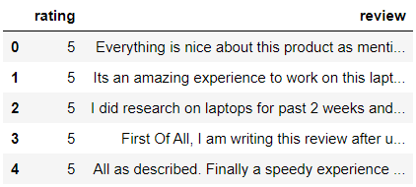
Dataset
The screen shot shows how the sample dataset after extraction

Slide 5
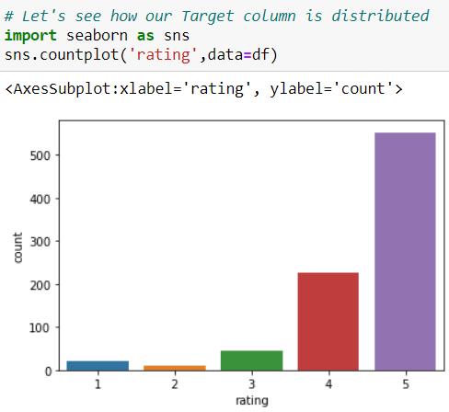
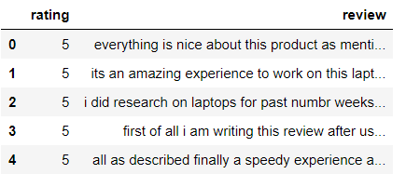
Part 2 - Modelling
Pre-processing:
Replaced, email ids, phone numbers, numbers, money symbols, web addresses, punctuations and white spaces from the reviews, with relevant common keywords.
Following Screen shot shows the table after pre-processing
Distribution of ratings

Slide 6
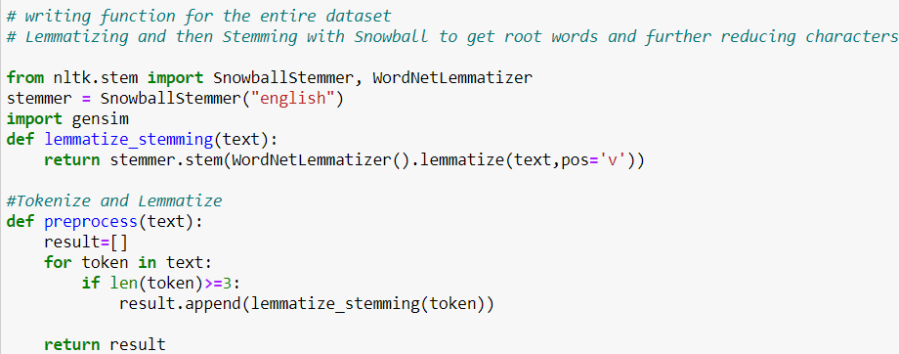
Removed Stop Words and Tokenized

Slide 7
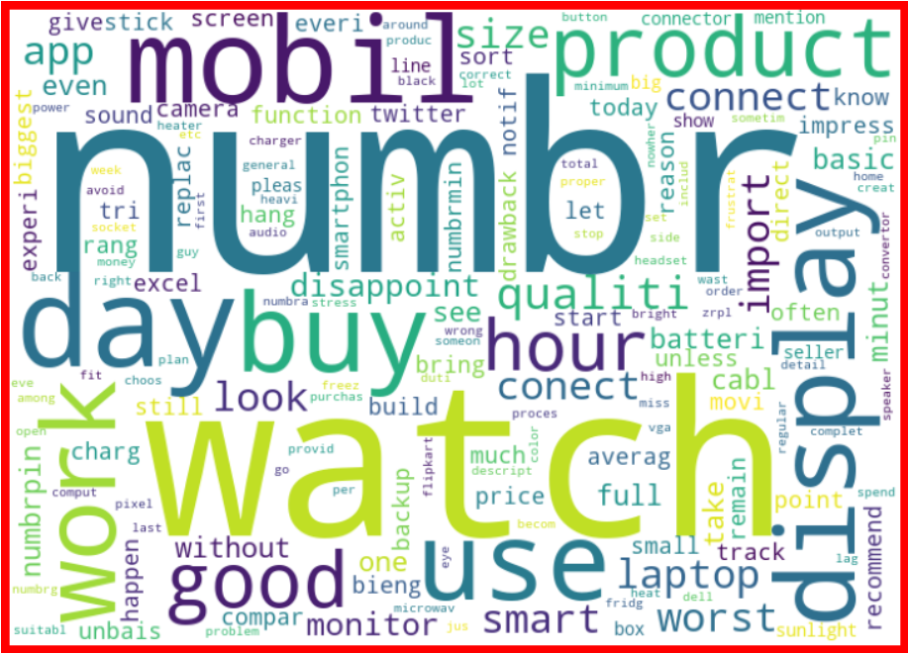
Word Cloud for Rating 1

Slide 8
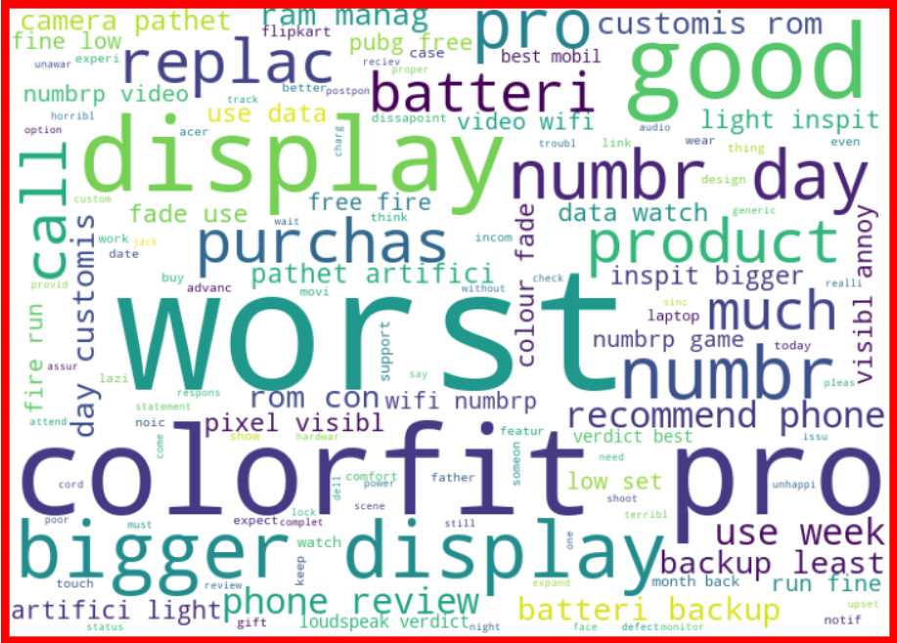
Word Cloud for Rating 2

Slide 9
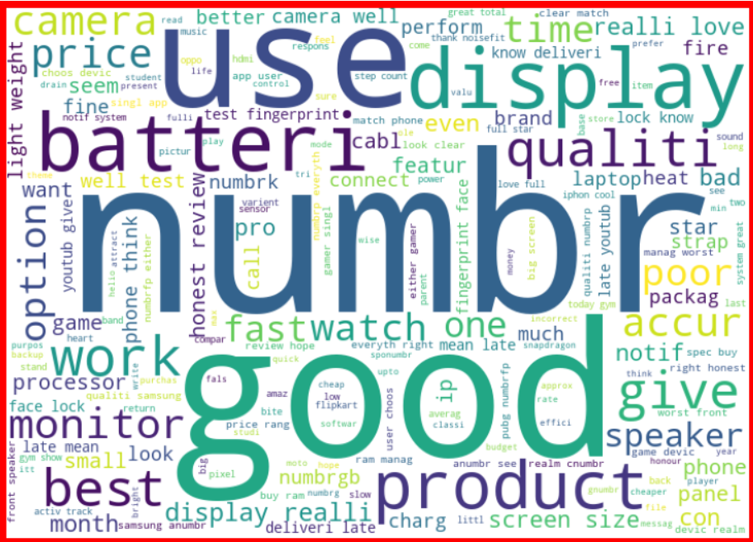
Word Cloud for Rating 3

Slide 10
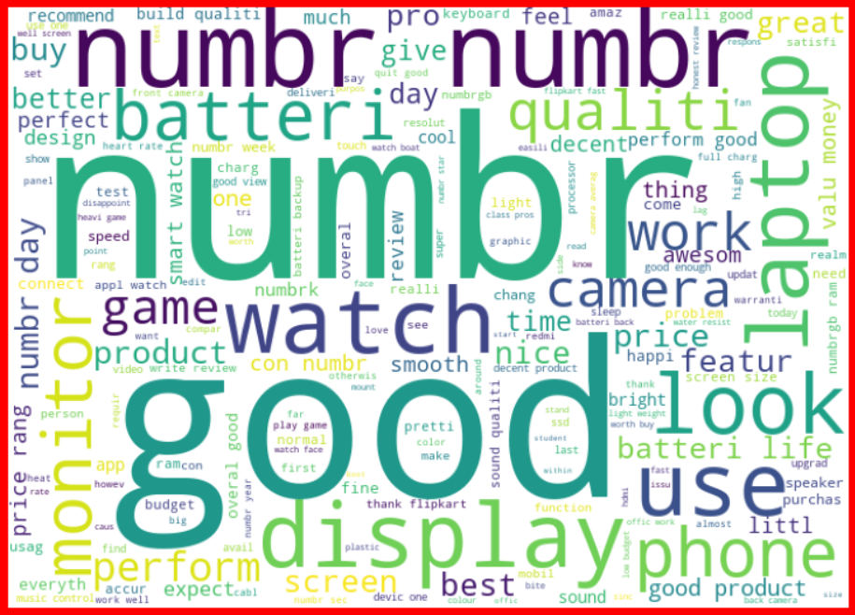
Word Cloud for Rating 4

Slide 11
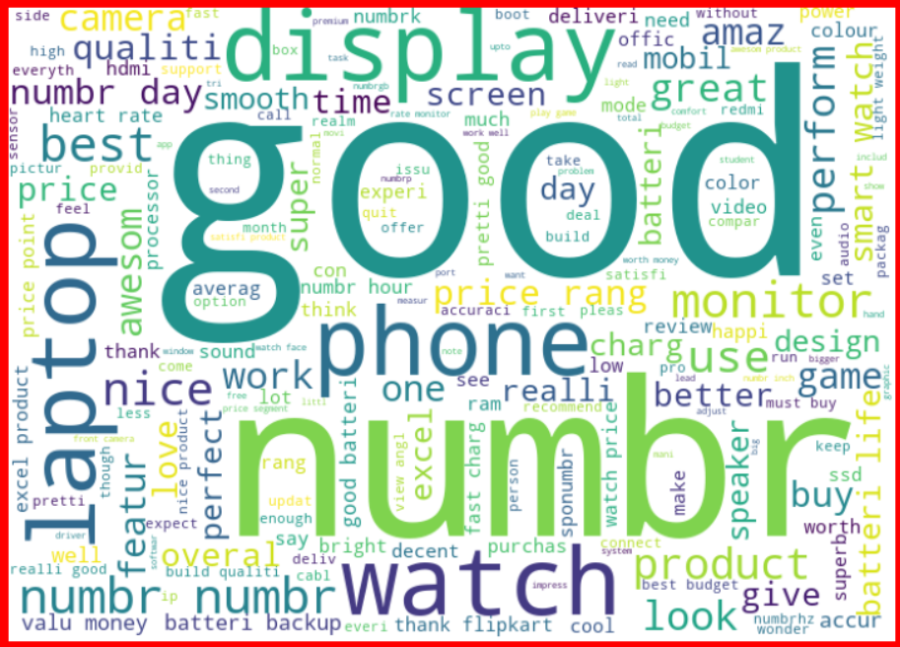
Word Cloud for Rating 5

Slide 12
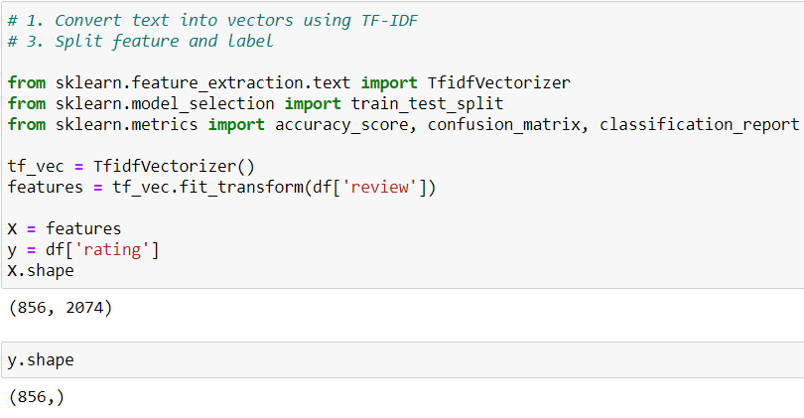
Before Model Building, Vectorizing the dataset
Also, prepared X and y variables for model building
Next, I have vectorized using tf-idf vectorizer so that words are arranged in a 2-d area based on similarity or difference in their meaning

Slide 13
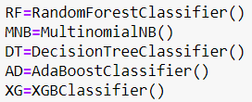
List of Models used:

Slide 14
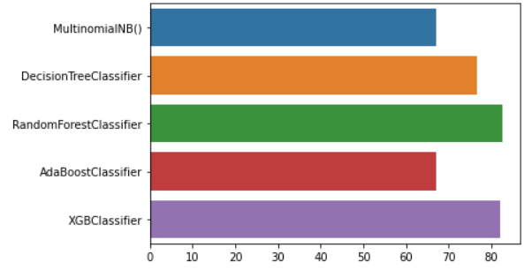
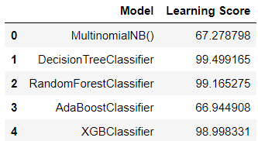
Model Comparisons:
Accuracy

Slide 15
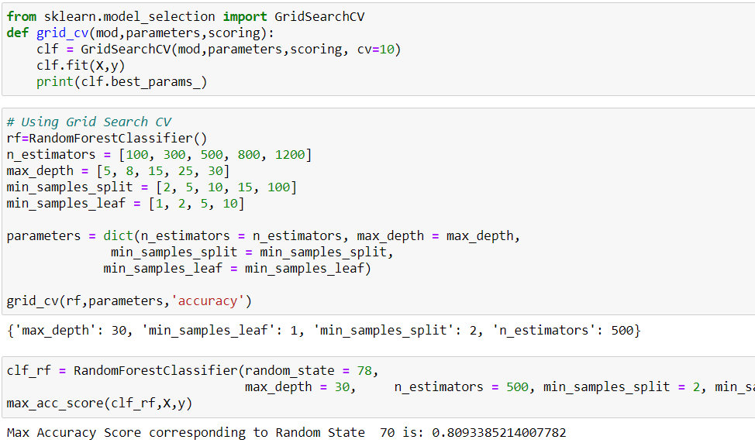
Random Forest Classifier gives best results. Hyperparameter Tuning
I have used Grid Search CV

Slide 16
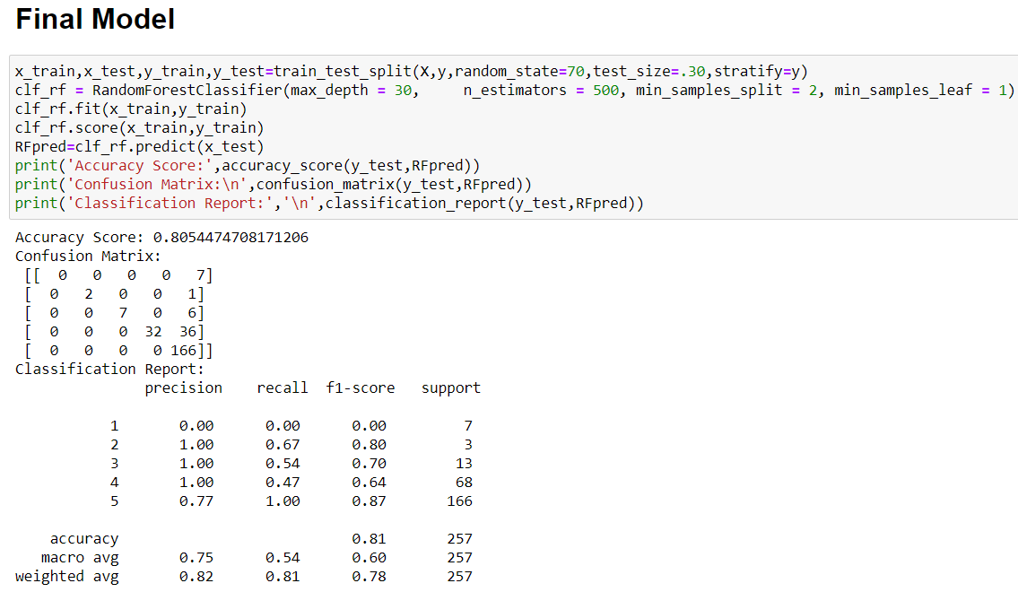
Final Model

Slide 17
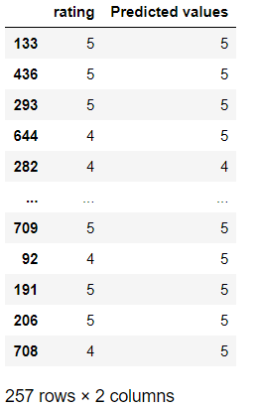
Sample Predictions

Slide 18
Conclusions and Scope of Improvements:
We have got a good accuracy score of more than 80 using Random Forest Classifier.
I have only been able to use 1 website – Flipkart, due to deadline and health issues, but using data from Various other sites like Amazon and Myntra etc can further enhance the model.
As my data was limited, I did not go for under-sampling, but it was needed as not all classes have equal percentage of data for model training. Ideally, I could have reduced the number of data points having Rating = 5, as that contributes to about 35-40% of the data.
More data needed for Ratings 1 and 2.

